Slide 1
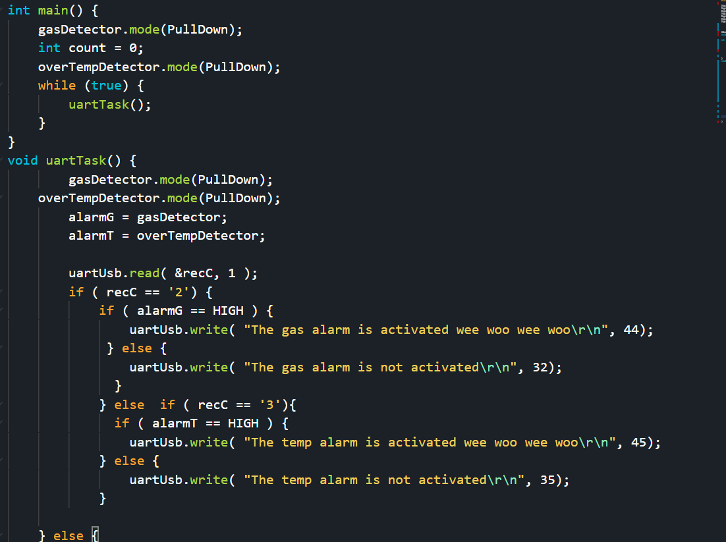
Embedded Systems Lab Worksheet
Student Name: Zeyad karima
ID Number: 23077460
Lab. Number: 3
Date: 02/20/2025
Lab Title:
Outline of Approach (Description of Tasks)
Itemize all key steps you took to build the required embedded system in a clear, logical and organised format.
1.Output the alarm state if buttons are sent to srerial
2.Output alarm state in serial at regular intrevals
3.Output a value for the temperature
4.Show warning
.
.
.
Reflection (Not more than 200 words)
I made a circuit that would send the output of 2 sensors into the serial monitor on the pc allowing for uart connections.
It was a good feeling to be able to connect serial and the board allowing for pc and board communication instead of using buttons.
It was good to make the uart connection work but it took some work and lots of errors which were annoying.
The situation was a good learning experience allowing me to understand how connections between pc serial monitor works compared to the button input from the old labs.
Ive learned how to read the input of serial monitor while also I learned how to make random numbers, W3schools.com. (2024), allowing for testing of the sensor code.
My action plan is to learn more about coding and different ways to increase my coding skills.
Github with video evidence: https://github.com/ZeyadK05/Lab-3
Results for Part:1
(Input only lab results, Git-hub code link, Flow chart, calculations or picture evidence of simulation/circuits/figures obtained).
All figures should be captioned with relevant title and a brief description to present the essential details).
The while loop repeats the functions which checks the serial input from the computer, if the number is detected it sends the state which is tested using buttons.
References
W3schools.com. (2024). W3Schools.com. [online] Available at: https://www.w3schools.com/cpp/cpp_howto_random_number.asp.

Slide 2
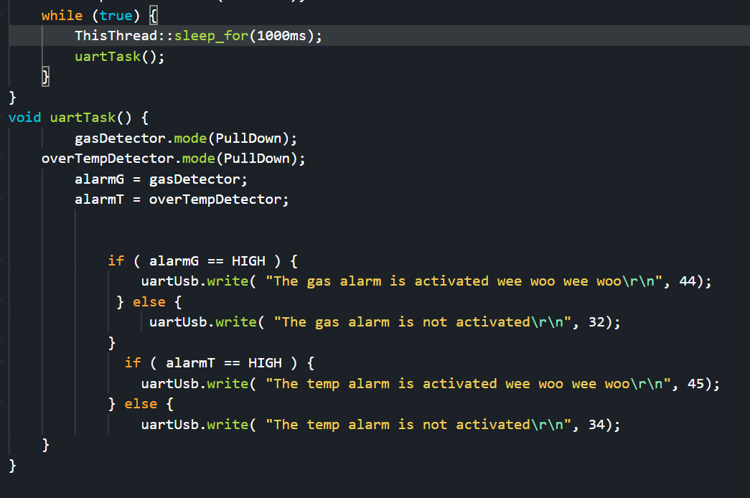
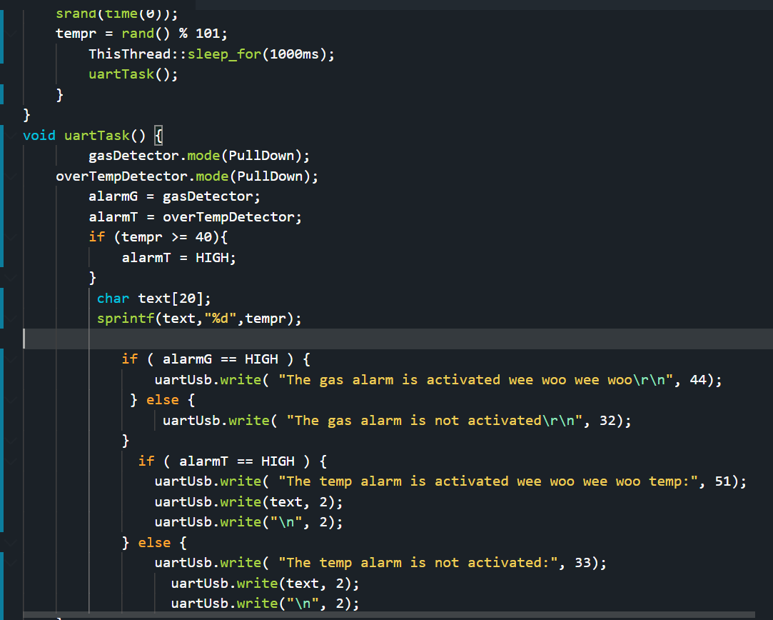
Results for Part:2
(Input only lab results, Git-hub code link, Flow chart, calculations or picture evidence of simulation/circuits/figures obtained).
All figures should be captioned with relevant title and a brief description to present the essential details).
By removing the user input from the computer and adding a timer in the while loop the code will send the alarm state to the serial at regular intrevals.
Results for Part:3
(Input only lab results, Git-hub code link, Flow chart, calculations or picture evidence of simulation/circuits/figures obtained).
All figures should be captioned with relevant title and a brief description to present the essential details).
Since we do not have a temp sensor yet I created a random number generator to generate a temperature, it is converted to char using sprint, and then printed out to show the temperature, the usb write (\n) is to create a new line after it is done showing the temperature value
Results for Part:4
(Input only lab results, Git-hub code link, Flow chart, calculations or picture evidence of simulation/circuits/figures obtained).
All figures should be captioned with relevant title and a brief description to present the essential details).

